Slide 1









E-BOT
DR.SAMAR HESHAM

Slide 2





Introduction
Welcome to our Emergency Interactive Chatbot Medical Assistance—an innovative solution for swift and efficient support during critical medical situations.
In times of urgency, access to accurate information and guidance can be a game-changer.
Our intelligent chatbot seamlessly blends advanced technology with compassionate care to provide immediate assistance.
Experience the future of emergency medical support with our innovative chatbot—because every second counts when it comes to saving lives.

Slide 3




PROBLEM
-The delayed administration of first aid for individuals with chronic illnesses and sudden health crises often results in many cases of fatalities
-Lack of awareness of emergency contact numbers and nearby hospital locations contributes to the challenge.

Slide 4
SOLUTION
-This app will be like an assistant that displays first aid tips you may need in emergency situations.
-In special cases, the app will directly connect to emergency services or one of the numbers specified by the user for immediate contact.

Slide 5




Objectives

Slide 6


Objectives
1
2
3
Real-time assistance and assessment of symptoms
first aid guidelines and integration with emergency services .
location based services and user-friendly and user education .

Slide 7


Diagrams

Slide 8


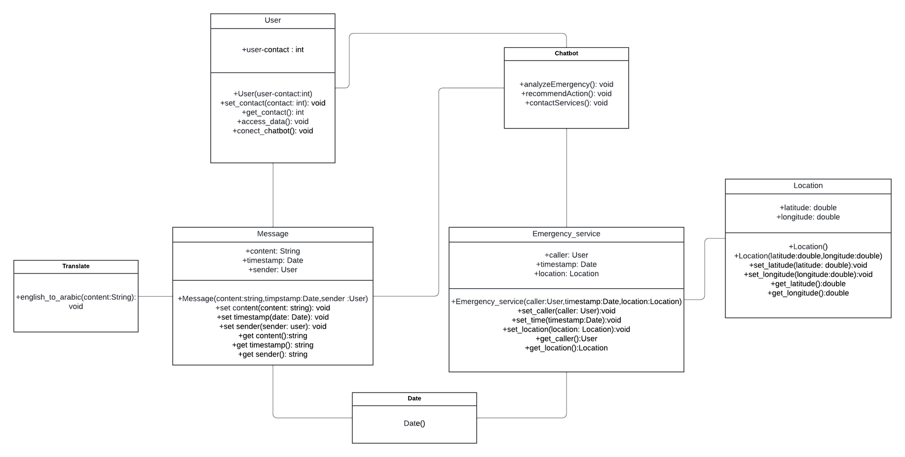

UML class diagram

Slide 9
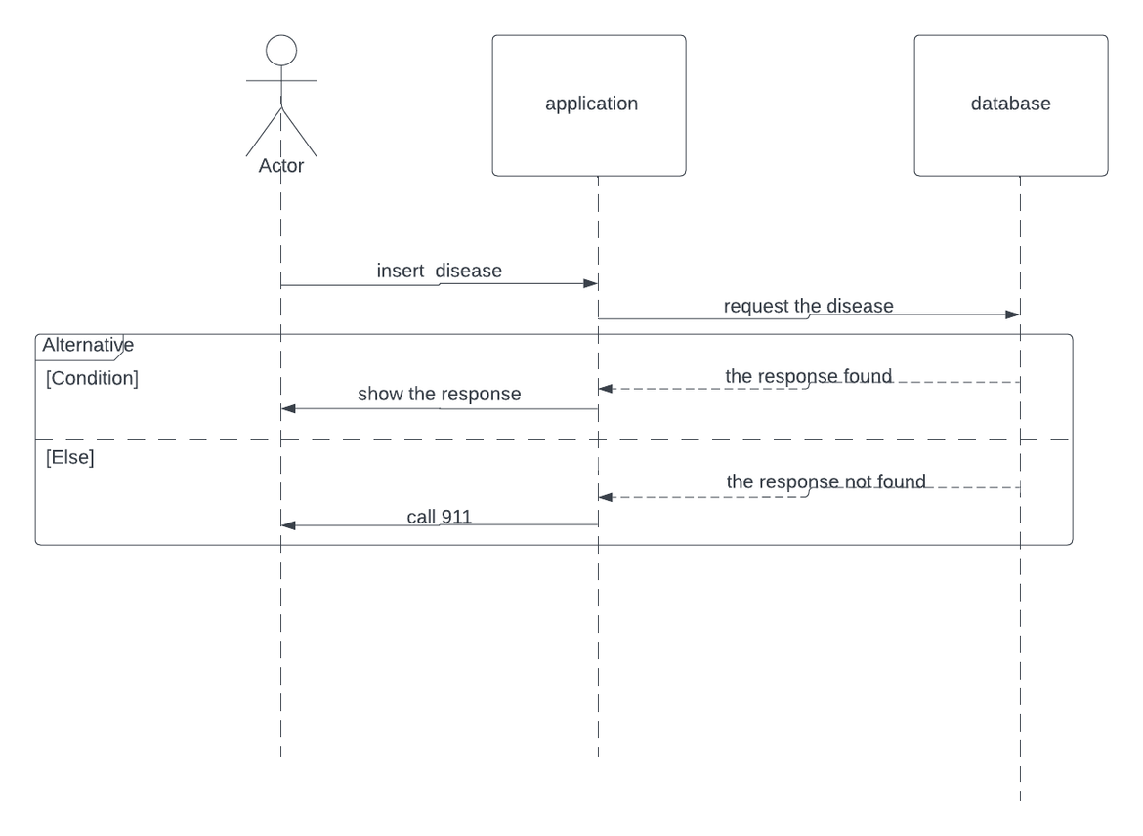
sequence diagram

Slide 10
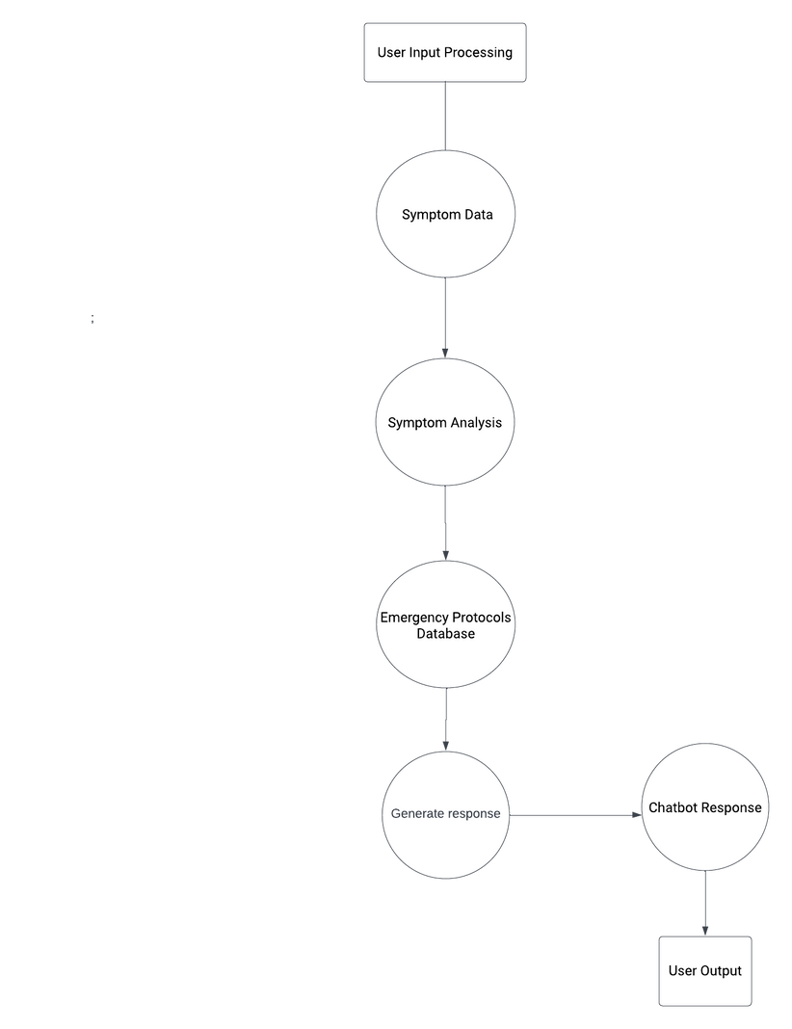
Dfd diagram

Slide 11





Conclusion
Our Emergency Interactive Chatbot Medical Assistance is more than a technological advancement; it's a lifeline. With precision and compassion, this chatbot empowers individuals during medical emergencies, offering immediate support, accurate guidance, and bridging the crucial gap until professional help arrives.
Experience the revolution—where cutting-edge technology meets unwavering commitment to your well-being. In emergencies, trust our chatbot to be your companion, ensuring that every second counts towards saving lives.

Slide 12


THANK YOU

